Slide 1
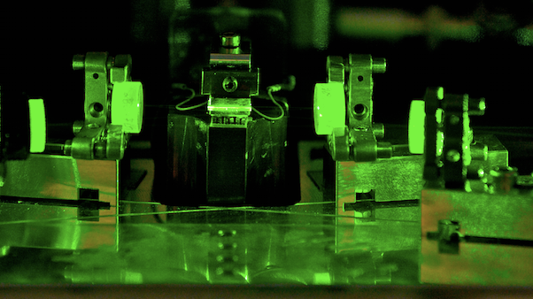

Real-Time Self-Testing Quantum Random Number Generator with
Non-classical States
Thibault Michel^{1,2}, J.Y. Haw^{1*}, D. G. Marangon^{3^}, O. Thearle¹,
G. Vallone^{3,4 #}, P. Villoresi^{3,4} , P. K. Lam¹, S.M. Assad¹
¹ CQC2T, DQS, Australian National University
²LKB, Sorbonne Université, CNRS, ENS-PSL Research University, Collège de France
³ Department of Information Engineering, Università degli Studi di Padova
⁴ Istituto di Fotonica e Nanotecnologie, Università degli Studi di Padova
Currently at: *ECE, NUS Singapore ^Toshiba, CRL #Dipartimento di Fisica e Astronomia
PhysRevApplied.12.034017
thibault.michel@anu.edu.au

Slide 2
Outline
Introduction and motivation
Principle of the self-testing QRNG
Protocol and experimental implementation
Results
Outlook

Slide 3
QKD requires secure and independent random numbers
Pseudo random numbers are intrinsically flawed
The “Quantum World” can provide intrinsic true randomness
  → Quantum Random Number Generators

Slide 4
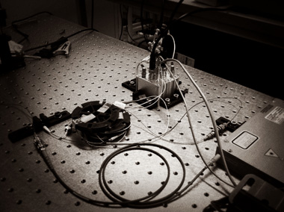
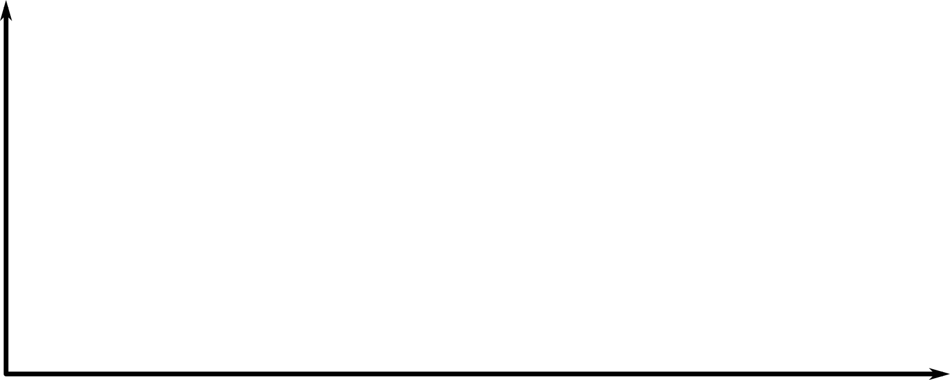
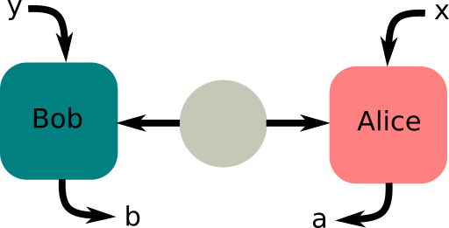
High bit rate (Gb/s) [1, 2]
Easy to implement
Need to trust the device
Device needs to be well characterized
Trusted device QRNG
Bit rate/ Ease of implementation
SDI-QRNG
[7, 8]
Device independent QRNG
Full security certified by non locality
Harder to implement
Slow bit rates (b-kb/s) [3-6]
ρ
Security/ Paranoia level
[1] Symul et al. (2011). Applied Physics Letters, 98(23), 231103.
[2] Abellán et al. (2019). Optics express 22.2: 1645-1654
[3] Liu et al. (2018). Physical review letters, 120(1), 010503.
[4] Bierhorst et al. (2018). Nature, 556(7700), 223-226.
[5] Qcrypt 2020. Yanbao Zhang et al. Device-independent Randomness Expansion with Entangled Photons.
[6] Qcrypt 2020. Wen-Zhao Liu et al. Device-independent randomness expansion against quantum side information.
[7] Lunghi et al. (2015). Physical review letters, 114(15), 150501.
[8] Marangon et al. (2017). Physical review letters, 118(6), 060503.

Slide 5
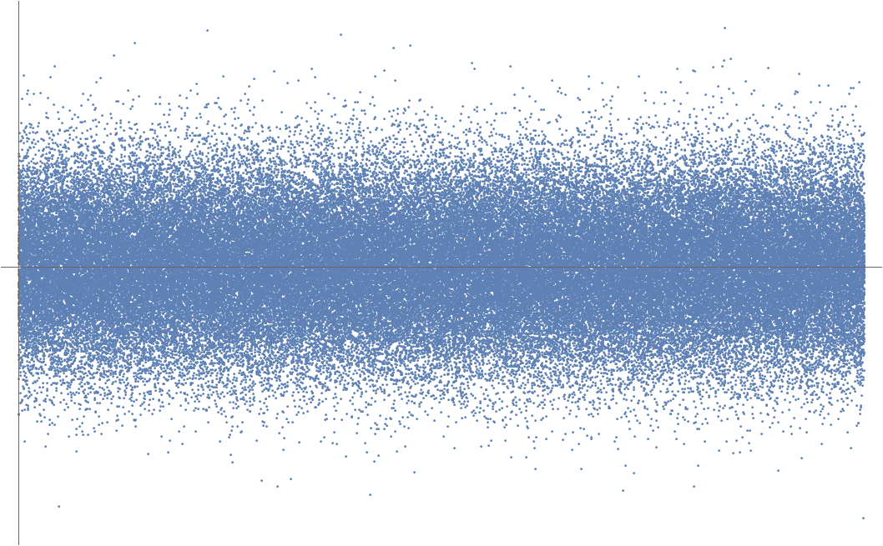
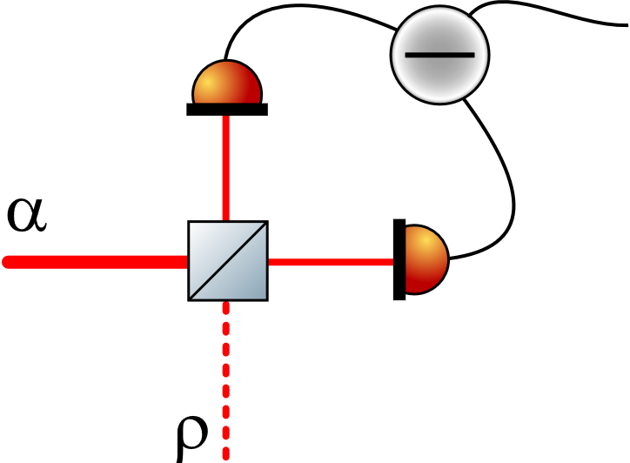
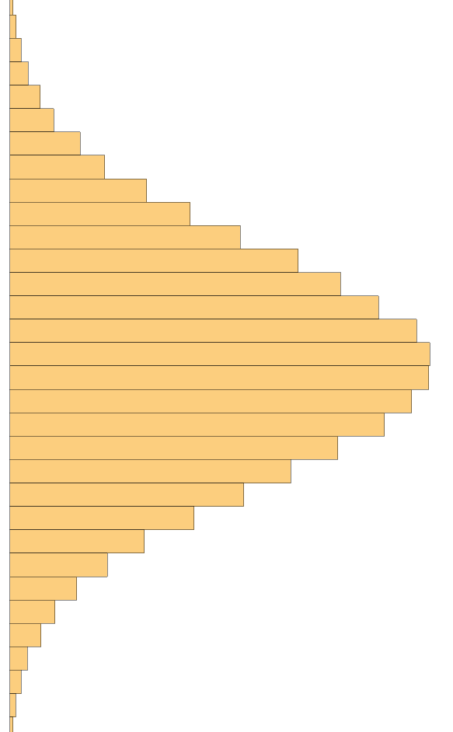
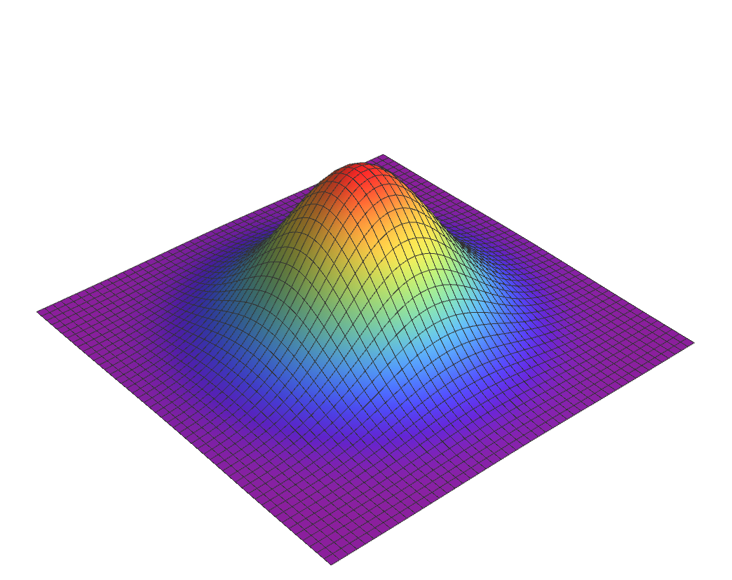

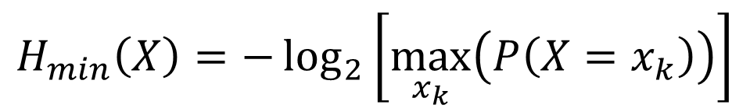

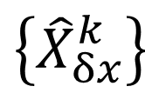
$$X$$
$$\left\{{\hat{X}}_{δx}^{k}\right\}$$
Local
oscillator
$$H_{min}=−\log_{2}\left(P_{guess}^{E}\right)$$
Entropy source
$$H_{min}\left(X\right)=−\log_{2}\left[\max_{x_{k}}\left(P\left(X=x_{k}\right)\right)\right]$$

Slide 6
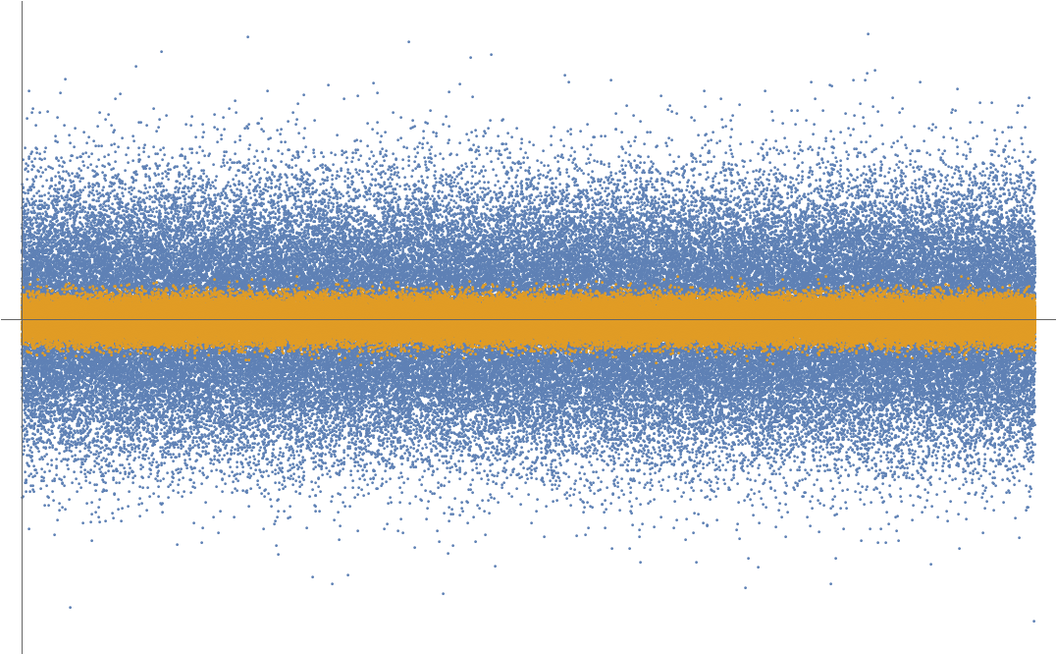
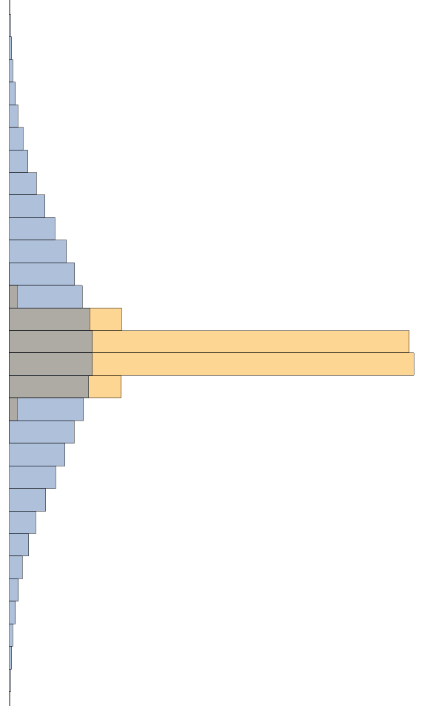
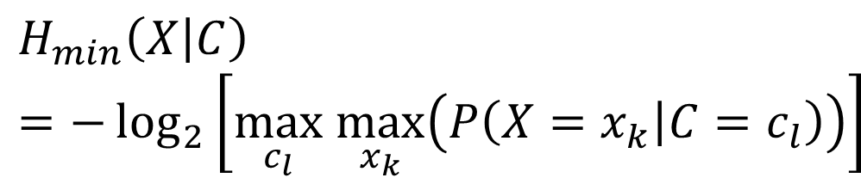

$$Z=X+C$$
$$\left\{{\hat{X}}_{δx}^{k}\right\}$$
Local
oscillator
Entropy source
$$H_{min}\left(X | C\right)=−\log_{2}\left[\max_{c_{l}} \max_{x_{k}}\left(P\left(X=x_{k} | C=c_{l}\right)\right)\right]$$
[1] Haw et al. (2015). Maximization of extractable randomness in a quantum random-number generator. Physical Review Applied, 3(5), 054004.

Slide 7
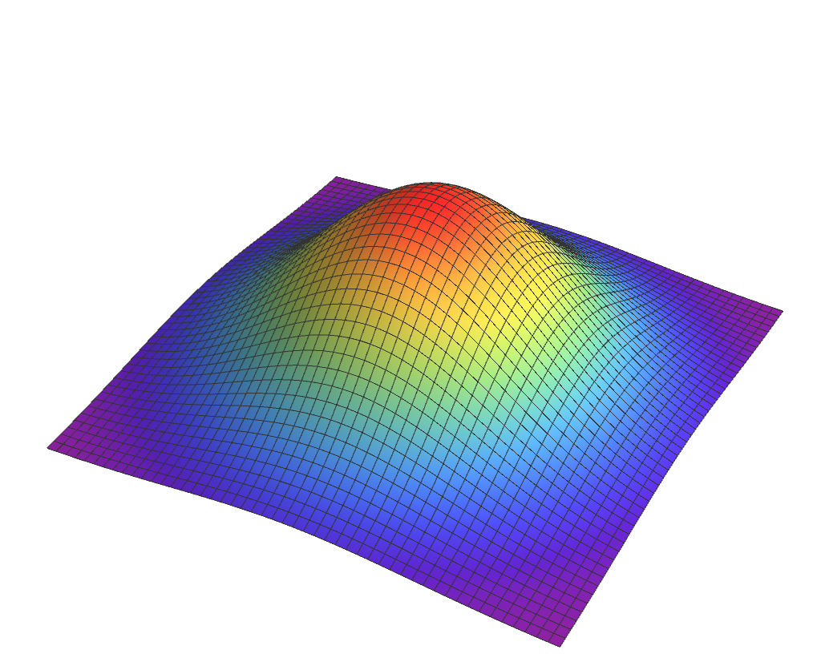



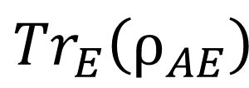
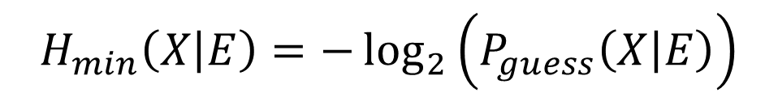
$$X$$
$$\left\{{\hat{X}}_{δx}^{k}\right\}$$
Local
oscillator
Entropy source
$$H_{min}\left(X | E\right)=−\log_{2}\left(P_{guess}\left(X | E\right)\right)$$
$${Tr}_{E}\left(ρ_{AE}\right)$$
$$A$$
$$E$$

Slide 8
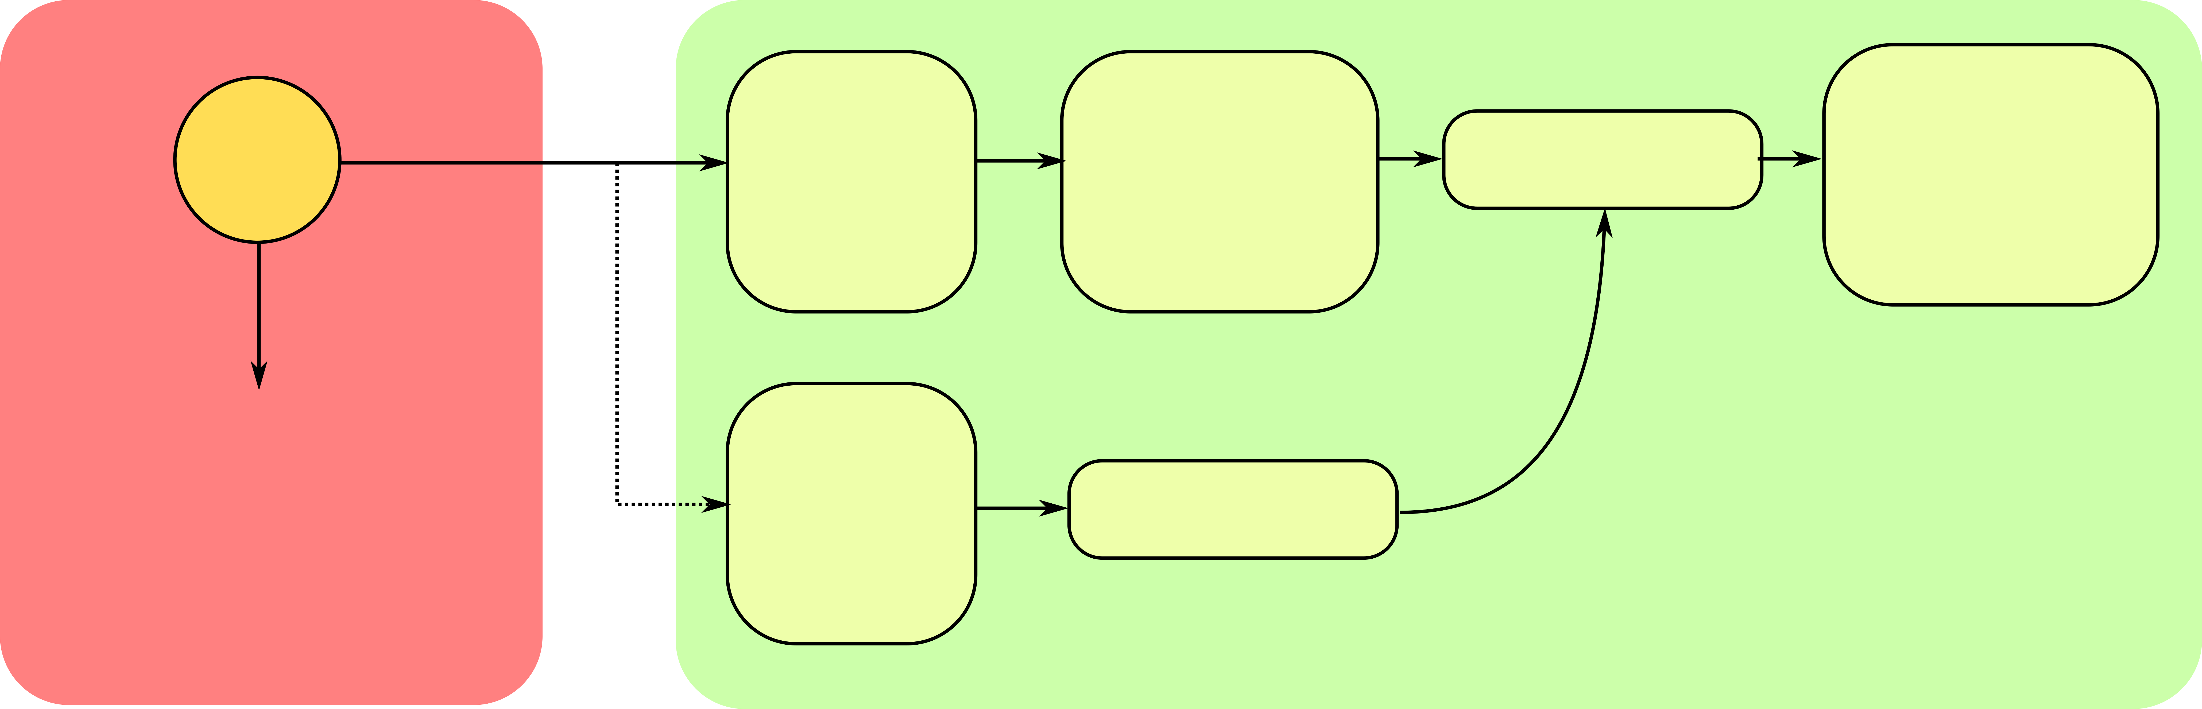






Entropic Uncertainty Relation (EUR):
$$H_{min}\left(X | E\right)≥H_{low}\left(P\right)=−\log_{2}{c\left(δx,δp\right)−H_{max}\left(P\right)}$$
$$H_{min}\left(X | E\right)+H_{max}\left(P\right)≥−\log_{2}{c\left(δx,δp\right)}$$
Eve
$$ρ_{A}$$
$$ρ_{AE}$$
POVM
Raw
Numbers
Extraction
Secure
Numbers
$$\left\{{\hat{X}}_{δx}^{k}\right\}$$
$$ρ_{E}$$
POVM
$$H_{min}\left(X | E\right)$$
Side Information
$$\left\{{\hat{P}}_{δp}^{k}\right\}$$
Alice
Assumptions:
  Trusted measurement device (untrusted classical noise)
  I.I.D. and bounded source (untrusted)

Slide 9
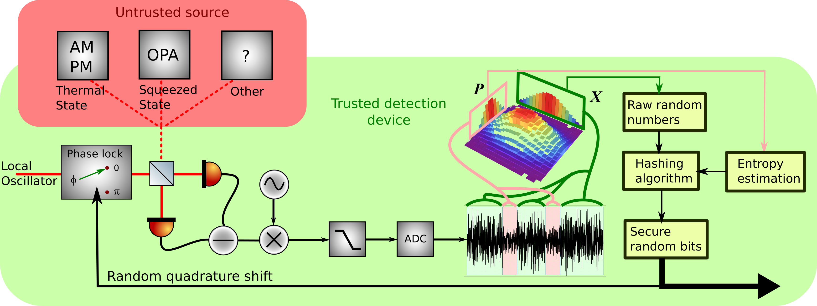
  Record dark and shot noise
  If P measurement: Collect data and estimate lower bound on conditional min-entropy with EUR and frequentist estimators
  If X measurement: Collect data, Hash it with Toeplitz matrix algorithm according to the bound
[1]
[1] N. D. Truong et al. "Machine Learning Cryptanalysis of a Quantum Random Number Generator," in IEEE Transactions on Information Forensics and Security, vol. 14, no. 2, pp. 403-414, Feb. 2019.

Slide 10
Features:
  Real-time
  Active Quadrature switching
  Self-testing, self-calibrating, self-sustaining
  Non-classical source: squeezed state of light

Slide 11
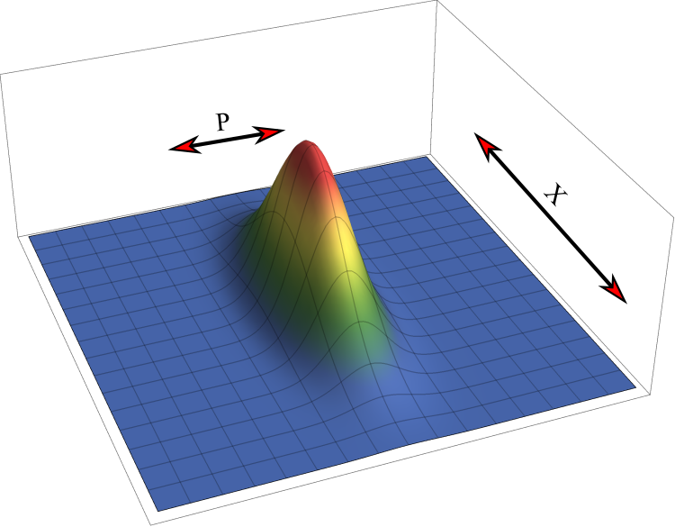
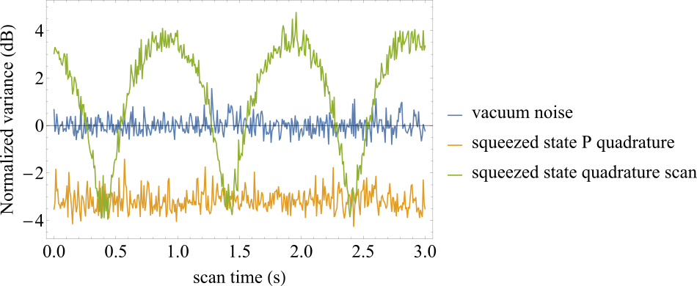
Squeezed State
Quadrature squeezed below shot-noise limit
Applications
  Quantum metrology, such as gravitational wave sensing [1, 2]
  Generation of entangled EPR state for quantum communication
  Quantum Information Processing
[1] Acernese, F., et al. "Increasing the astrophysical reach of the advanced Virgo detector via the application of squeezed vacuum states of light." Physical Review Letters 123.23 (2019): 231108.;
[2] Tse, M., et al. "Quantum-enhanced advanced LIGO detectors in the era of gravitational-wave astronomy." Physical Review Letters 123.23 (2019): 231107.

Slide 12
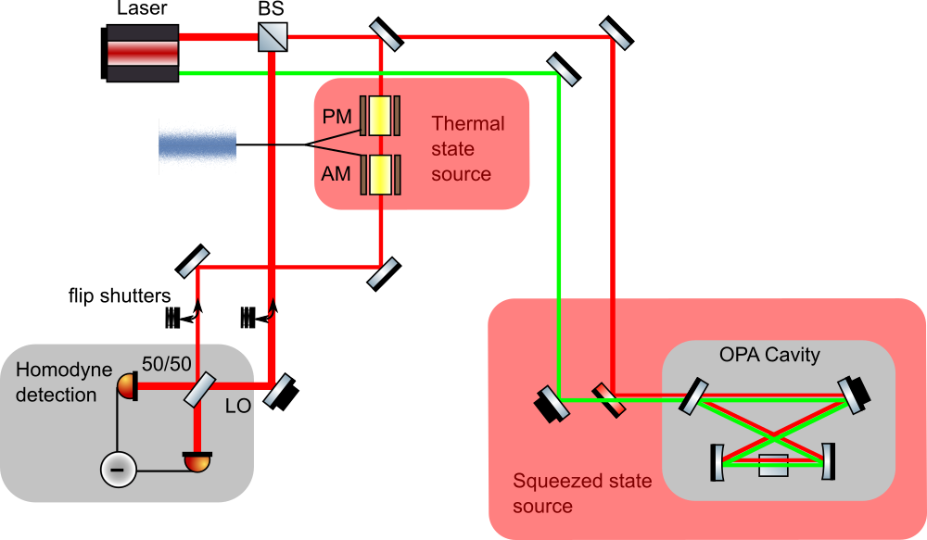

Slide 13
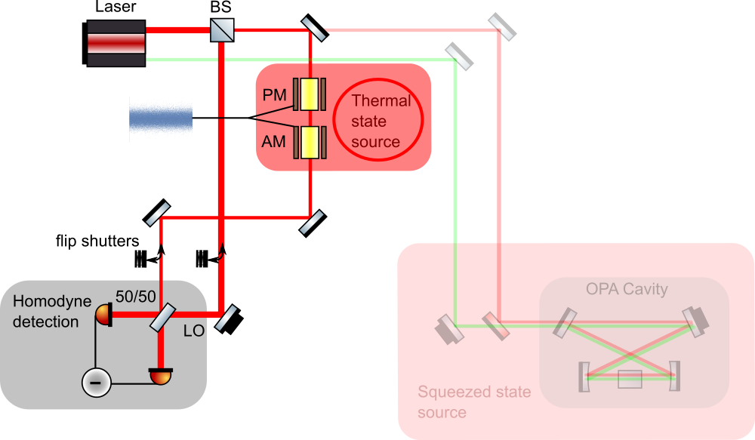

Slide 14
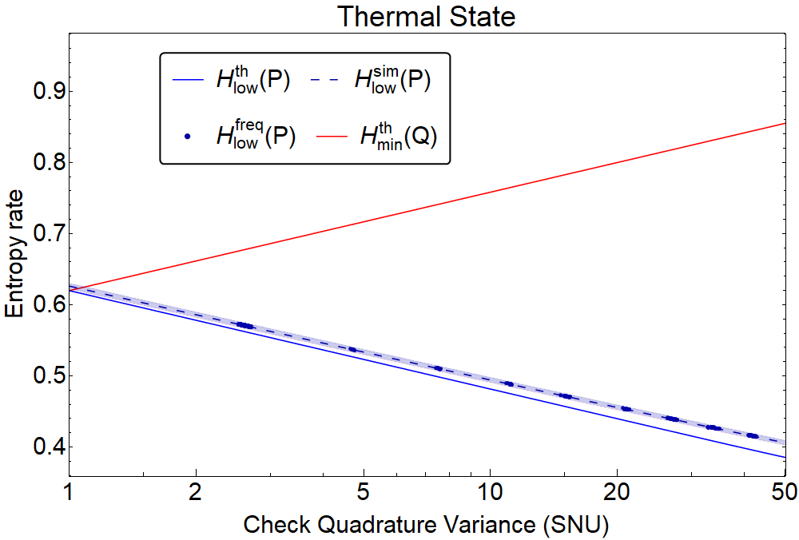
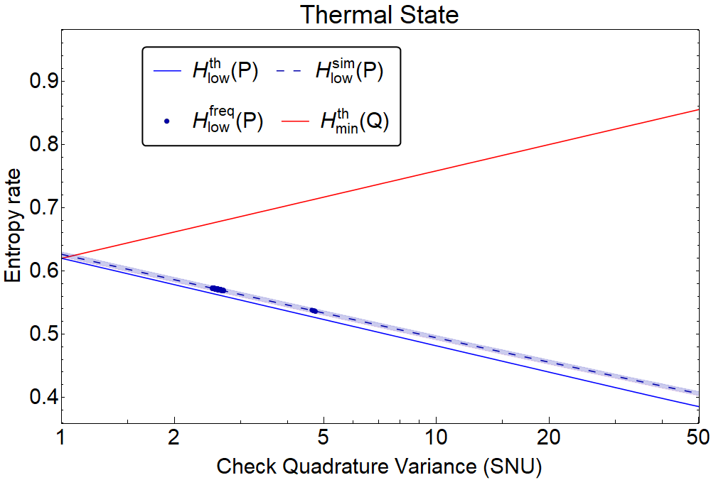
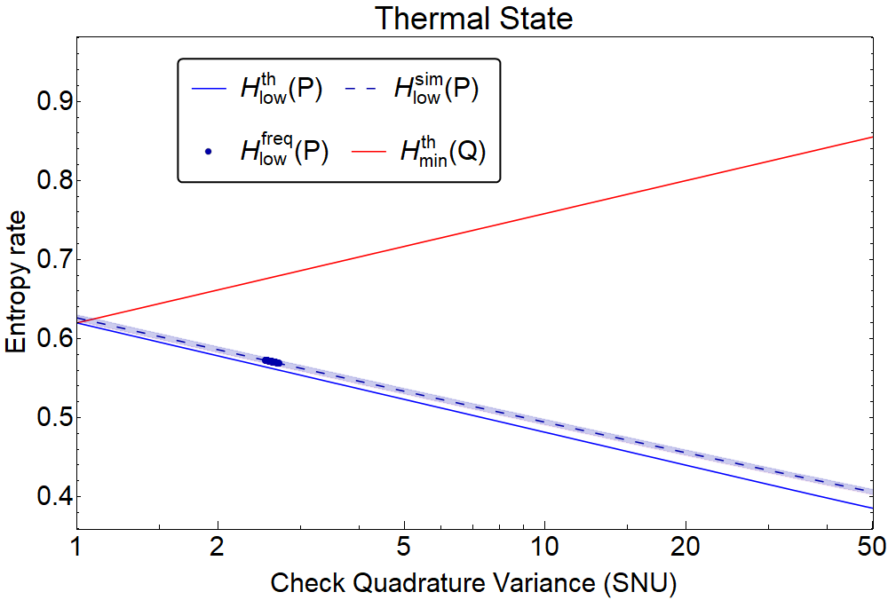


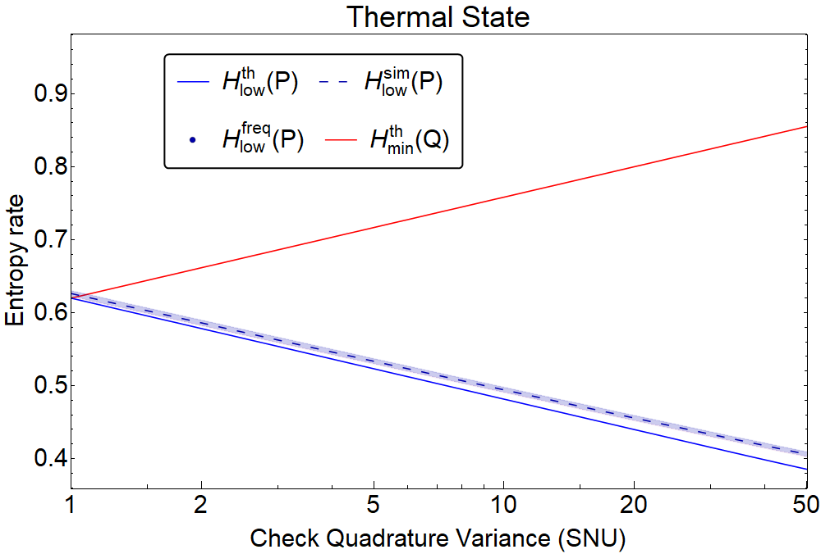


Results
Untrusted randomness
Trusted randomness

Slide 15
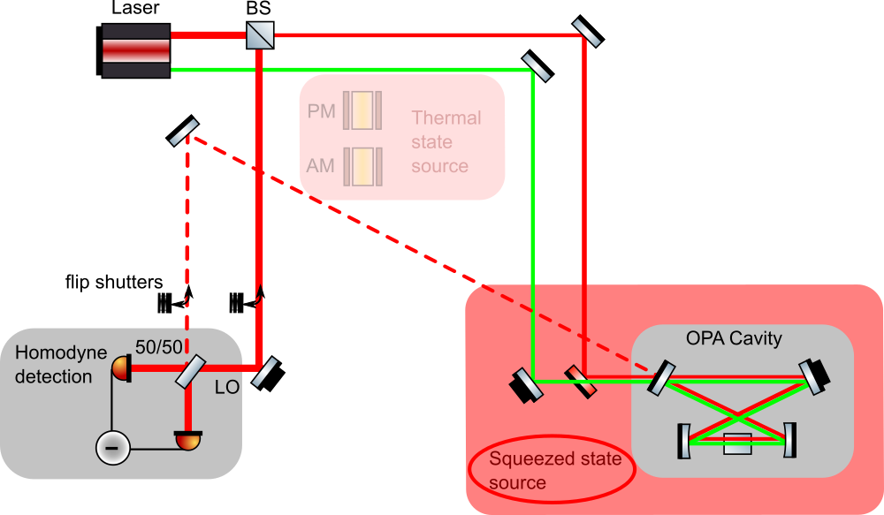

Slide 16
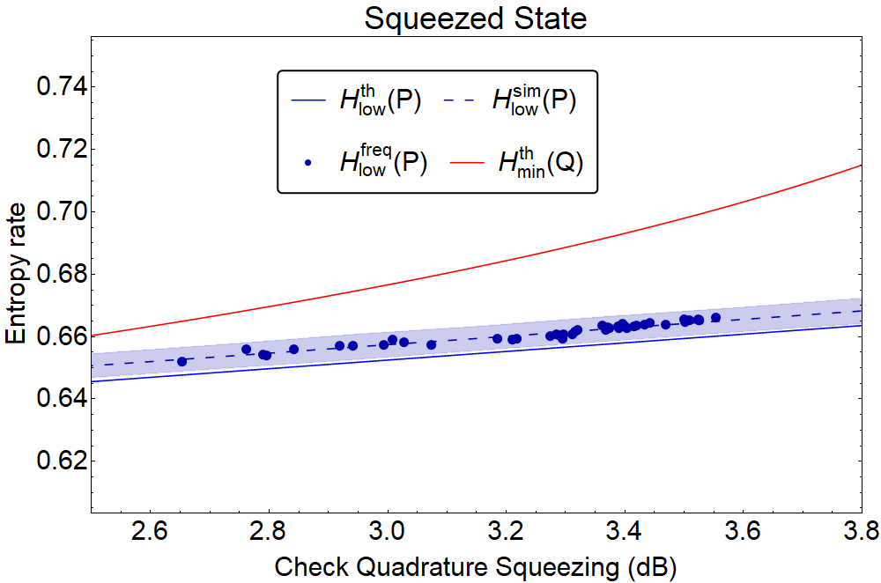

Slide 17
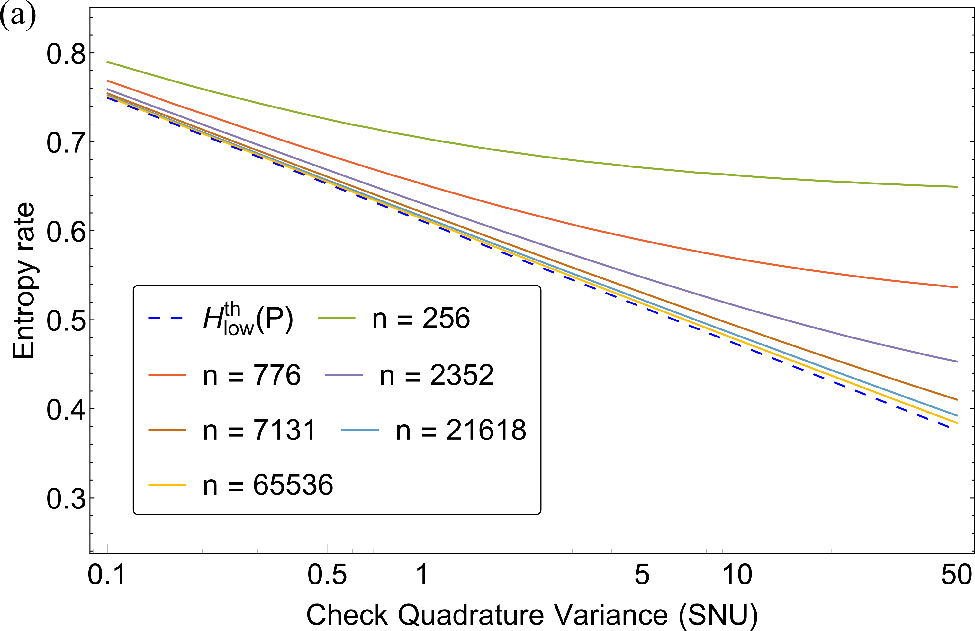
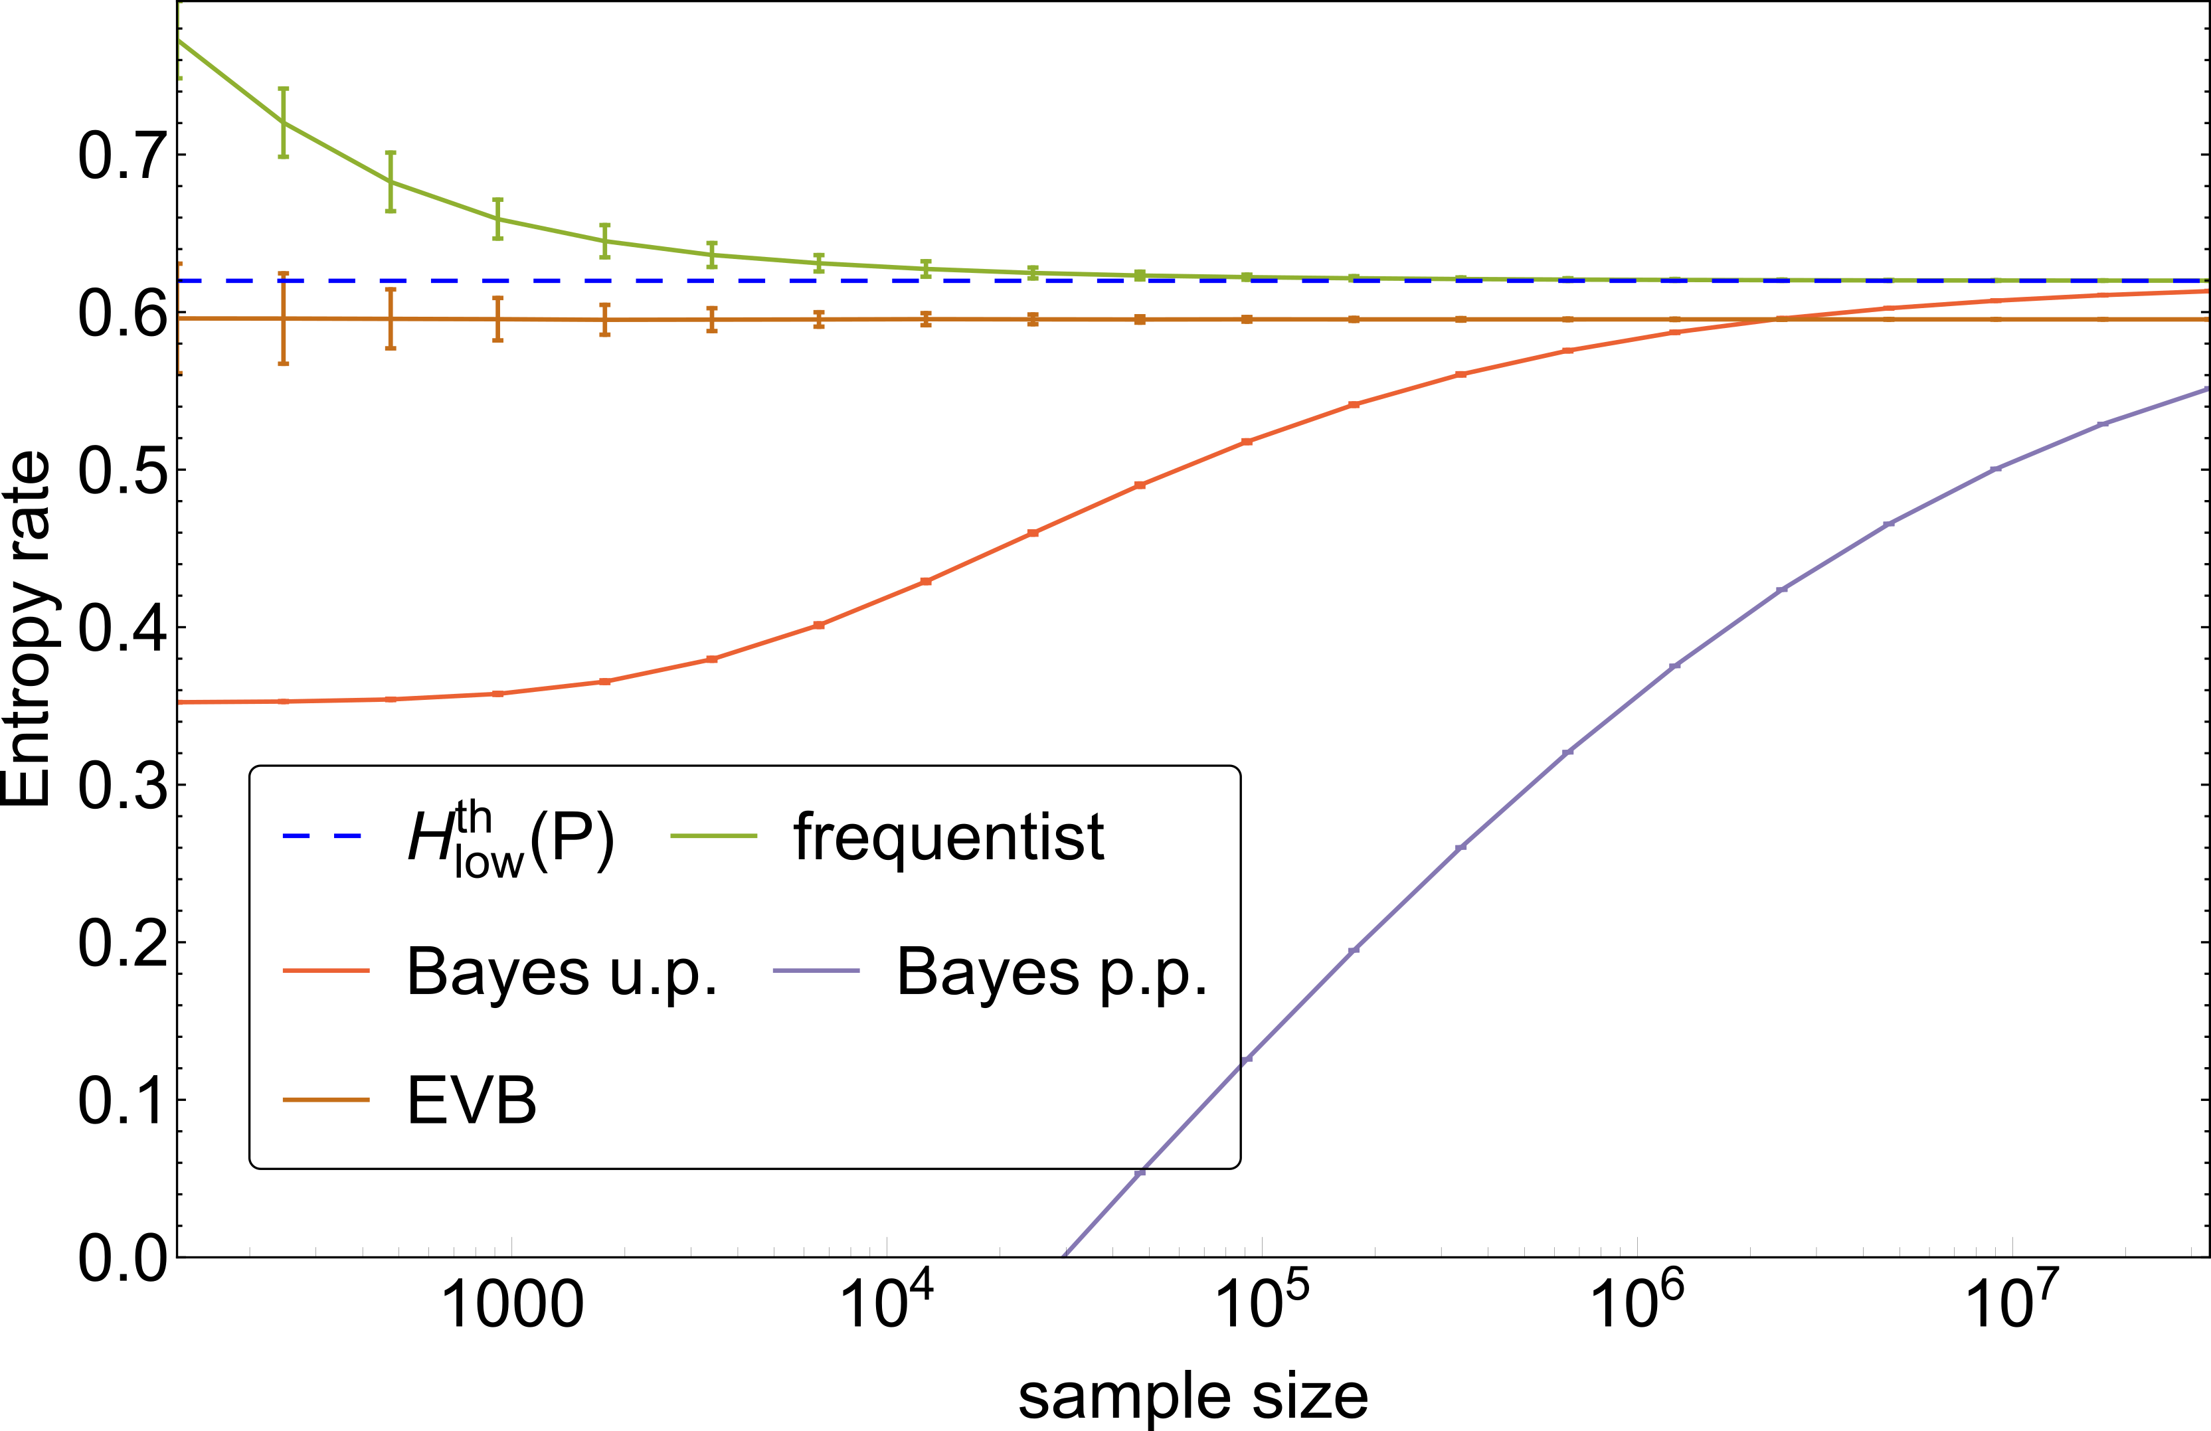
Finite size effects

Slide 18
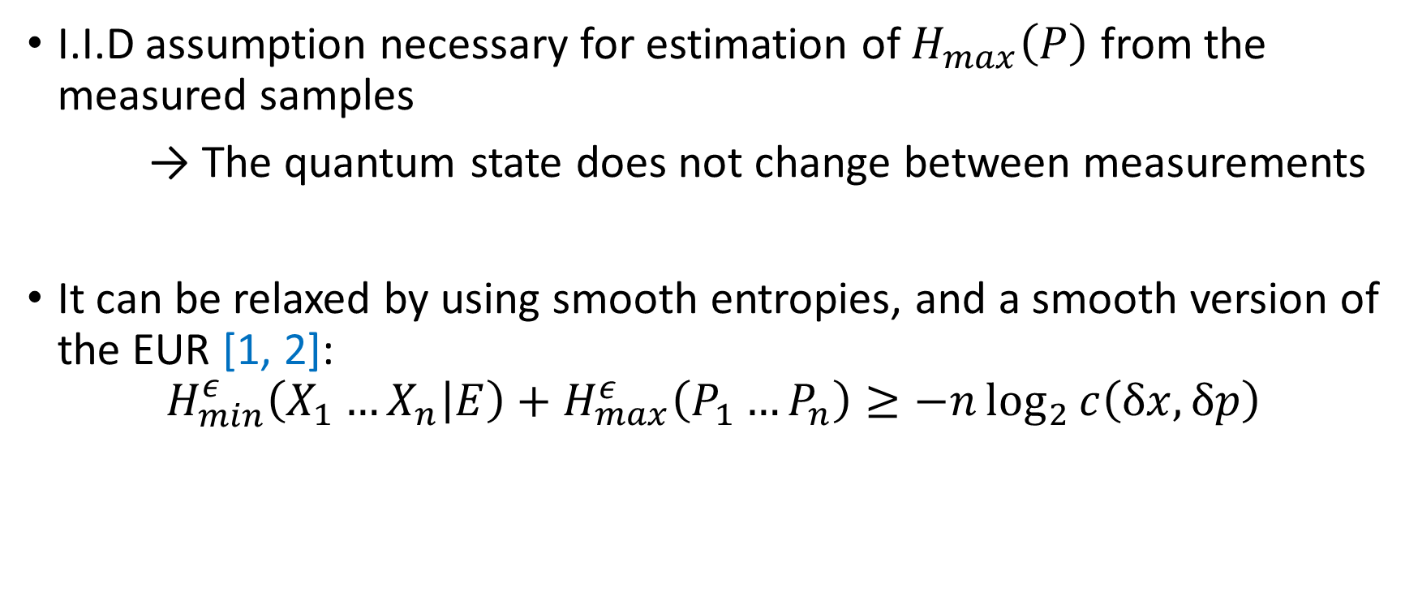
Relaxing the I.I.D assumption
I.I.D assumption necessary for estimation of $H_{max}\left(P\right)$ from the measured samples
→ The quantum state does not change between measurements
It can be relaxed by using smooth entropies, and a smooth version of the EUR [1, 2]:
$$H_{min}^{ε}\left(X_{1}…X_{n} | E\right)+H_{max}^{ε}\left(P_{1}…P_{n}\right)≥−n\log_{2}{c\left(δx,δp\right)}$$
[1] Tomamichel, et al. (2011). Uncertainty relation for smooth entropies. Physical review letters, 106(11), 110506.
[2] Coles et al. (2017). Entropic uncertainty relations and their applications. Reviews of Modern Physics, 89(1), 015002.

Slide 19
Relaxing the bounded state assumption
Finite measurement range R
→ Energy bound assumption is necessary
→ Rounds with extremal values, if any, are discarded
There are modified versions of the EUR to circumvent the measurement range problem [1]
The modified EUR converges to the original EUR when R is large compared to spread of the source
[1] Bourassa et al. (2019). Entropic uncertainty relations and the measurement range problem, with consequences for high-dimensional quantum key distribution. JOSA B, 36(3), B65-B76.

Slide 20
Conclusion & Outlook
We demonstrated a real-time, self-testing QRNG based on non-classical light.
We tested the QRNG with different sources and demonstrated the advantage of using squeezed light.
Speed limitation can be overcome with:
  Dedicated hardware for hashing
  Broadband squeezing
  Optical beam switching
Device can be miniaturized with on-chip squeezer and homodyne detection.

Slide 21

Thank you for your attention!
Real-Time Source-Independent Quantum Random-Number Generator with Squeezed States
Thibault Michel, J.Y. Haw, D. G. Marangon, O. Thearle,
G. Vallone, P. Villoresi , P. K. Lam, S.M. Assad
PhysRevApplied.12.034017
thibault.michel@anu.edu.au

Slide 22
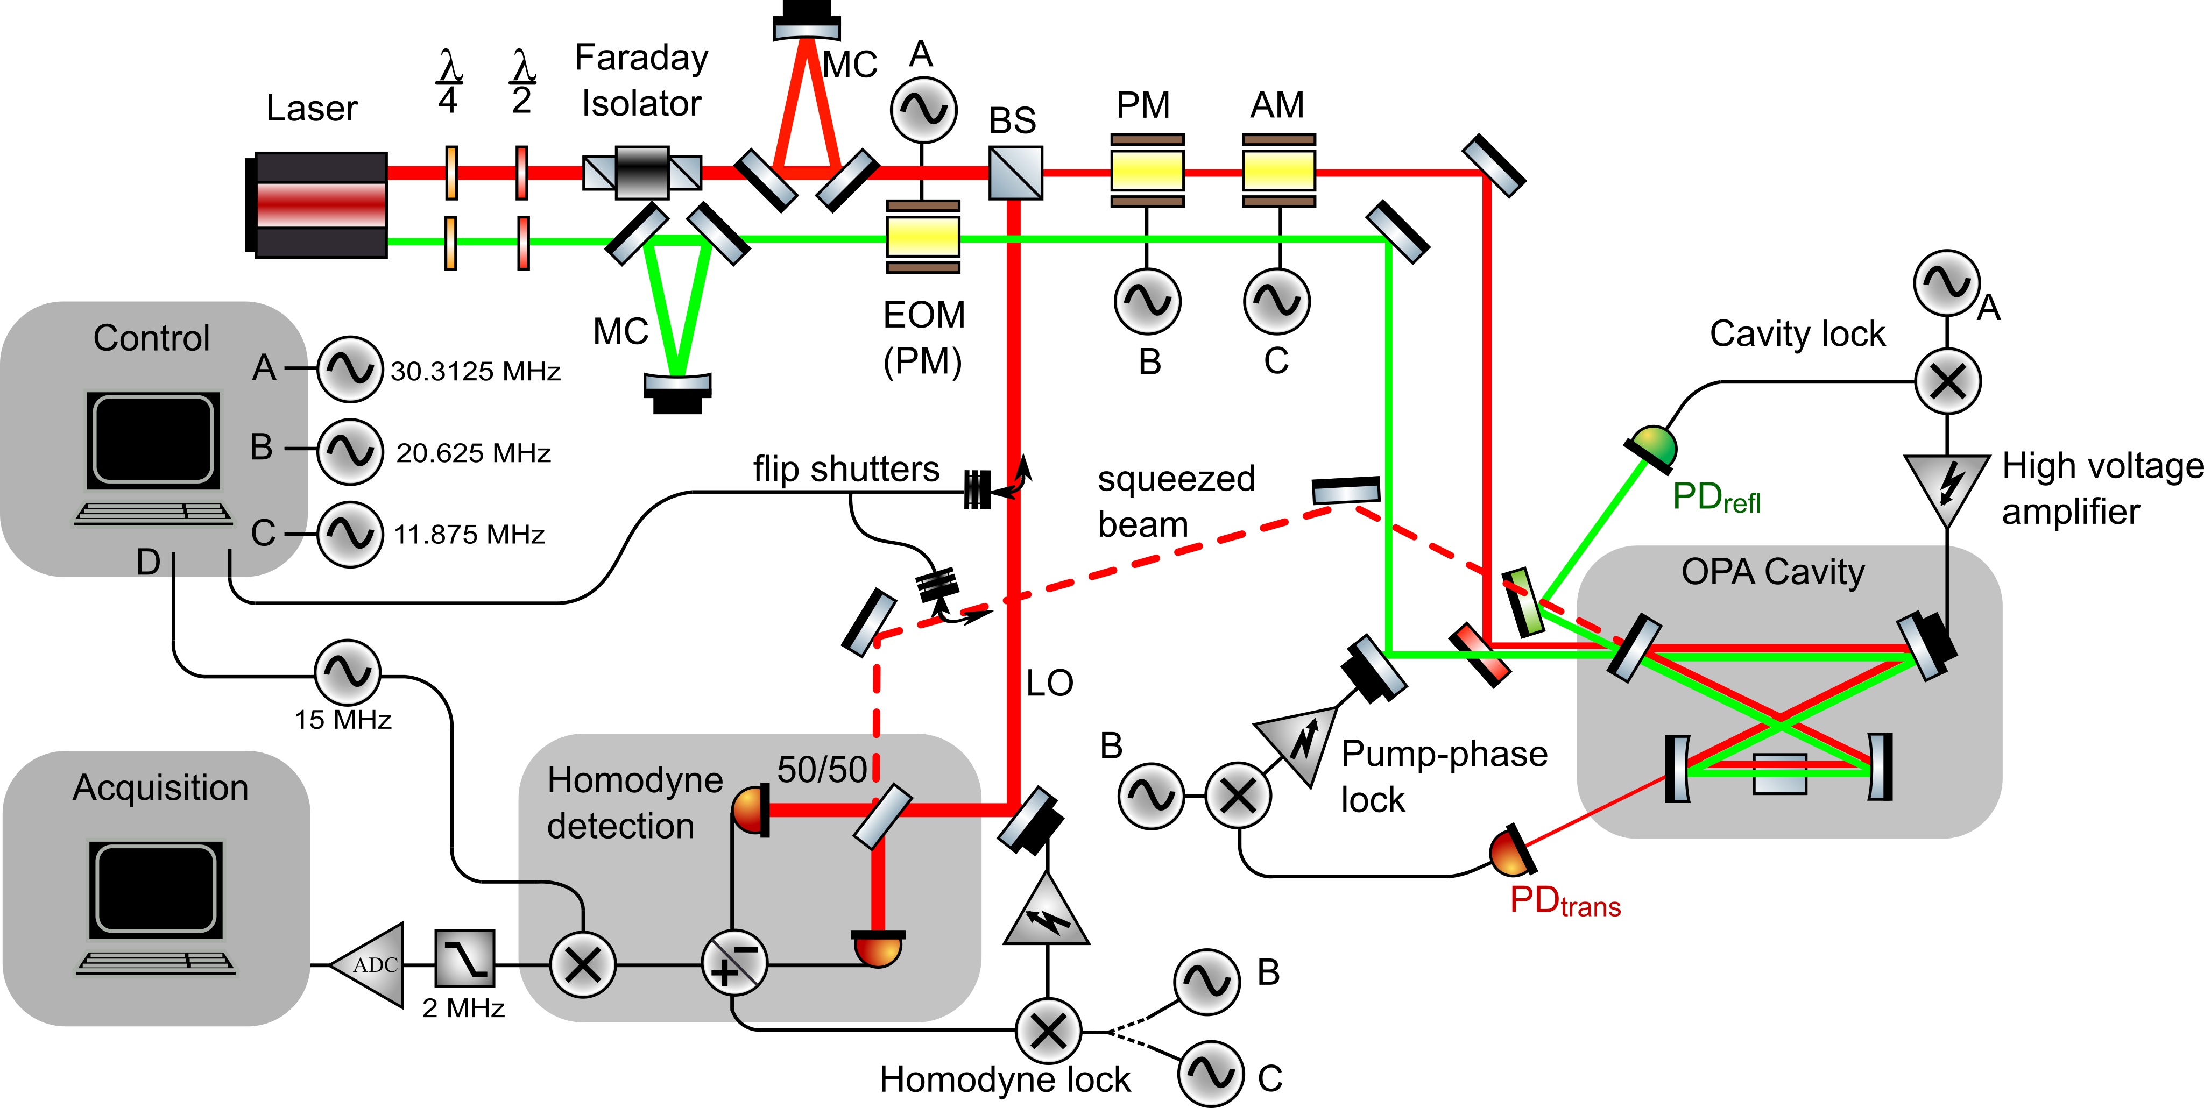

Slide 23
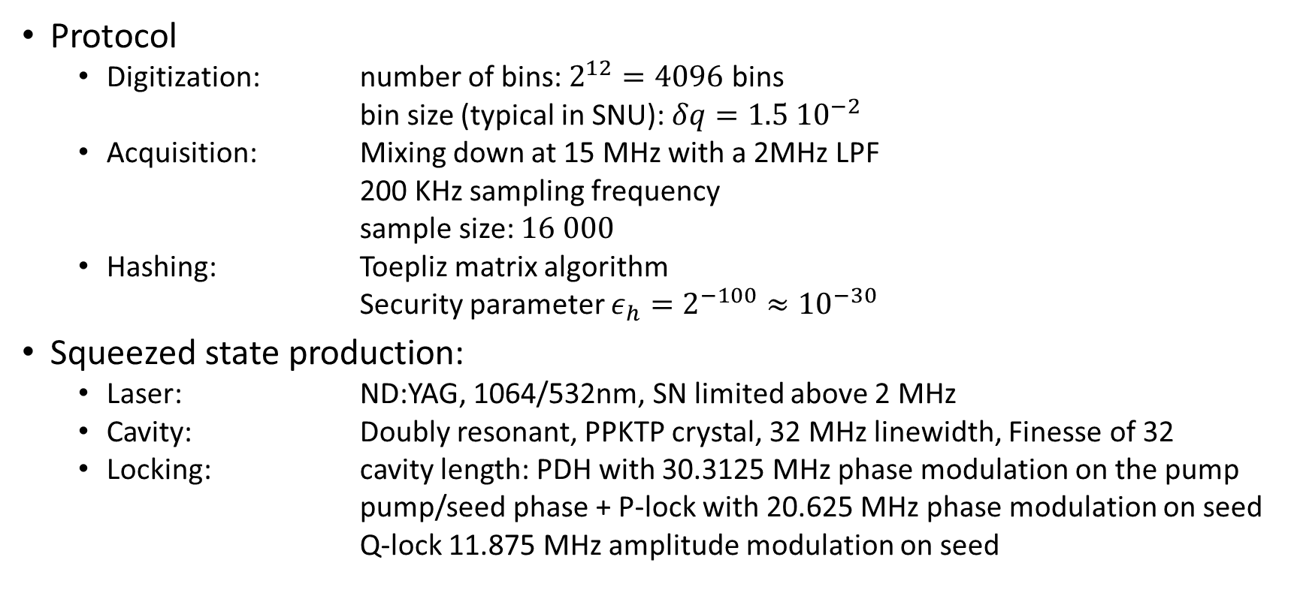
Details of experimental parameters
Protocol
  Digitization: number of bins: $2^{12}=4096$ bins
  bin size (typical in SNU): $δq=1.5 {10}^{−2}$
  Acquisition: Mixing down at 15 MHz with a 2MHz LPF
  200 KHz sampling frequency
  sample size: $16 000$
  Hashing: Toepliz matrix algorithm
  Security parameter $ε_{h}=2^{−100}≈{10}^{−30}$
Squeezed state production:
  Laser: ND:YAG, 1064/532nm, SN limited above 2 MHz
  Cavity: Doubly resonant, PPKTP crystal, 32 MHz linewidth, Finesse of 32
  Locking: cavity length: PDH with 30.3125 MHz phase modulation on the pump
  pump/seed phase + P-lock with 20.625 MHz phase modulation on seed
  Q-lock 11.875 MHz amplitude modulation on seed

